Slide 1




Capstone Project Phase B
Estimation Of Smoking Associated Damage Based On Nuclear Lung Images
Presented by:
Hani Zahran
Tareq Sleiman
Supervisor: Dr. Zeev Frenkel

Slide 2

Goals of the Lung Image Analysis Program
Enhance Diagnostic Accuracy: Utilize advanced algorithms to improve precision in lung disease detection.
Boost Diagnostic Efficiency: Reduce diagnostic time with real-time image processing capabilities.
Improve User Experience: Simplify operations with an intuitive, customizable interface.
Support Clinical Decisions: Integrate seamlessly with existing systems to aid medical decision-making.

Slide 3
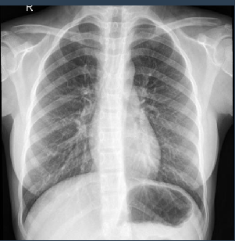
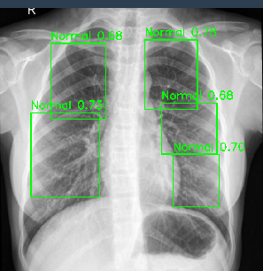
Background

Slide 4
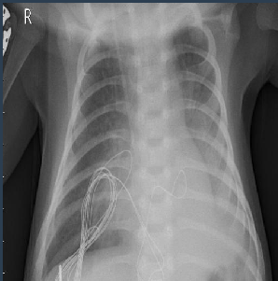
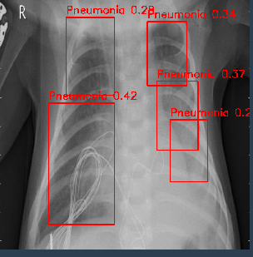
Background

Slide 5

Advanced AI for Enhanced Lung Image Analysis
Model Overview:
Technology: Utilizing a state-of-the-art Convolutional Neural Network (CNN), specifically tailored for high-precision medical image analysis.
Features: Incorporates advanced features like deep learning layers for automatic feature extraction and pattern recognition, enhancing the detection of nuanced lung pathologies.

Slide 6
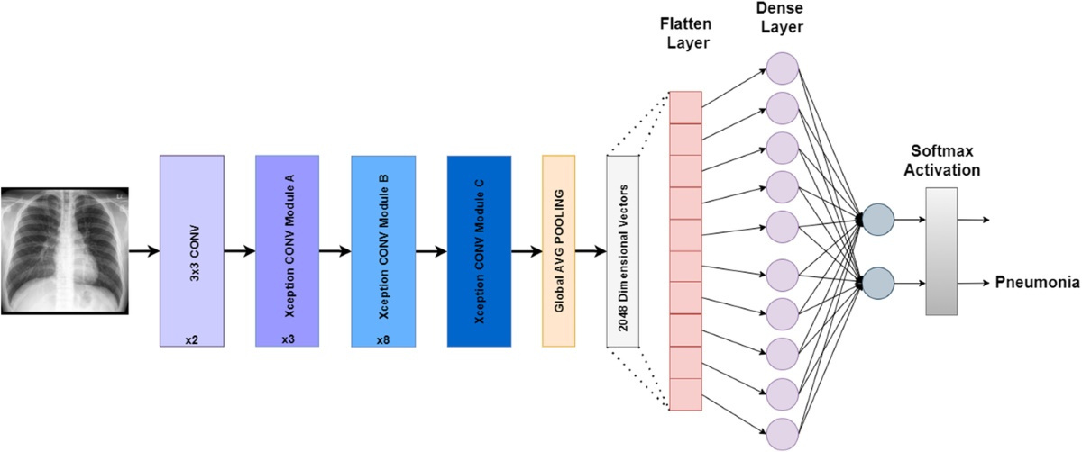
Flatten Layer
Dense Layer
Normal

Slide 7
Training and Development:
Data Training: Trained on a comprehensive dataset comprising over 2000 annotated lung X-ray images to cover a broad spectrum of lung conditions.
Techniques Employed: Employed supervised learning with robust data augmentation techniques to improve generalization over unseen images, ensuring the model performs reliably in diverse clinical environments.

Slide 8
Purpose of the Model:
The primary objective of our lung image analysis program is to significantly enhance the precision and speed of lung disease diagnosis through advanced image analysis. This model is specifically designed to:
Detect and Classify Lung Pathologies
Support Clinical Decision-Making
Improve Patient Outcomes
Detect non-lungs images

Slide 9
This model leverages cutting-edge machine learning techniques, including a Convolutional Neural Network (CNN) powered by YOLOv5, to process and analyze medical imaging data efficiently and accurately.

Slide 10
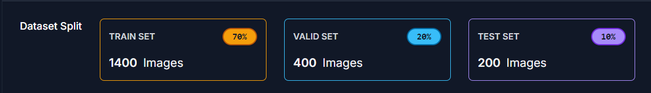
Dataset:
Our dataset was downloaded from Roboflow from this link.
The dataset contains labels for each image so this makes it easier for YOLOv5 to train the model.

Slide 11
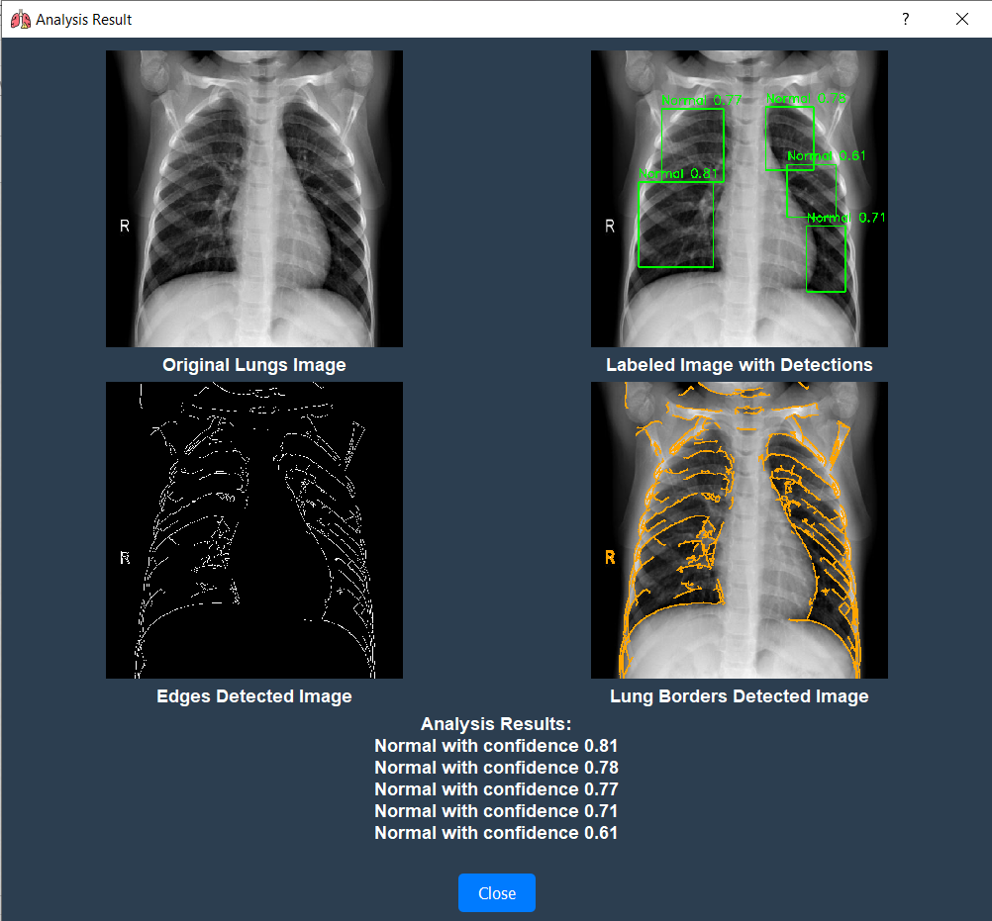

Slide 12
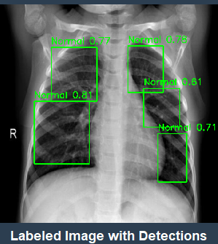
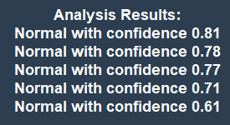
Analyzing Lung Images with AI
The model applies trained convolutional neural networks to detect and label regions in the lungs. Each detected region is marked with a bounding box and a confidence score, indicating the model’s certainty in its classification (in our example it is Normal with varying confidence levels).

Slide 13
Pseudo Code Overview
BEGIN LungImageAnalysis
Input: Lung X-ray Image
Output: Diagnostic Results including Condition,
Confidence Level
FUNCTION LoadModel
Load pretrained YOLOv5 model from disk
Return model
END FUNCTION
FUNCTION PreprocessImage(image)
Resize image to match model input requirements
Normalize image pixel values
Return preprocessed image
END FUNCTION
FUNCTION AnalyzeImage(model, preprocessedImage)
detections = model.predict(preprocessedImage)
Return detections
END FUNCTION
FUNCTION PostProcess(detections)
Filter detections based on confidence threshold
Classify detections into categories (Normal, Pneumonia)
Calculate diagnostic metrics (e.g., sensitivity, specificity)
Return diagnostic results
END FUNCTION
Main
model = LoadModel()
preprocessedImage = PreprocessImage(Lung X-ray Image)
detections = AnalyzeImage(model, preprocessedImage)
results = PostProcess(detections)
Display results
END Main
END LungImageAnalysis

Slide 14
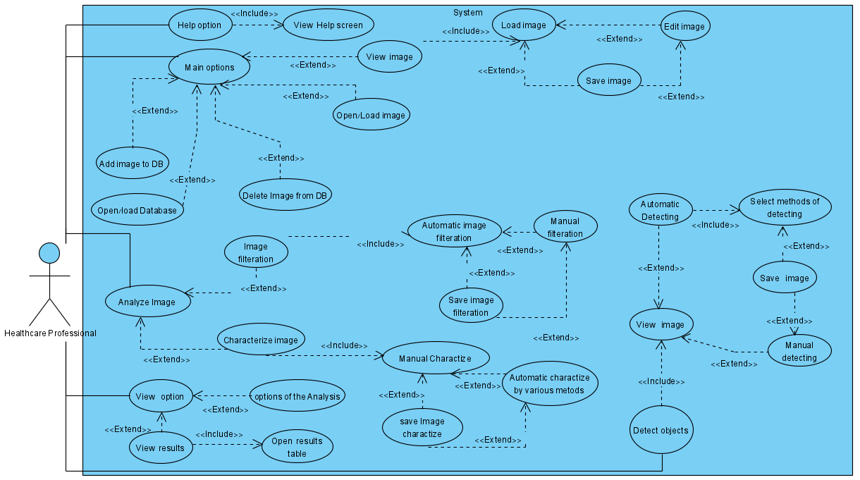
Use Case

Slide 15
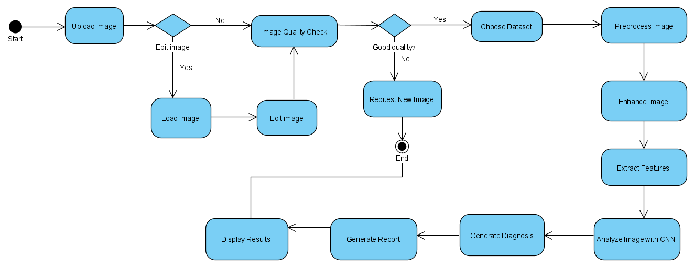
Activity Diagram

Slide 16





Development Workflow Overview
python
+
Testing Algorithm
Real vs Simulation
Our analysing tool
Planning for phase a
Prototype

Slide 17
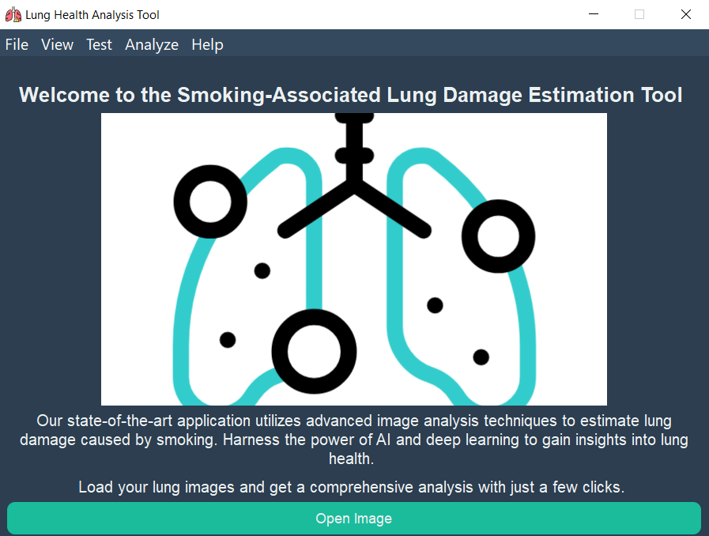
GUI

Slide 18
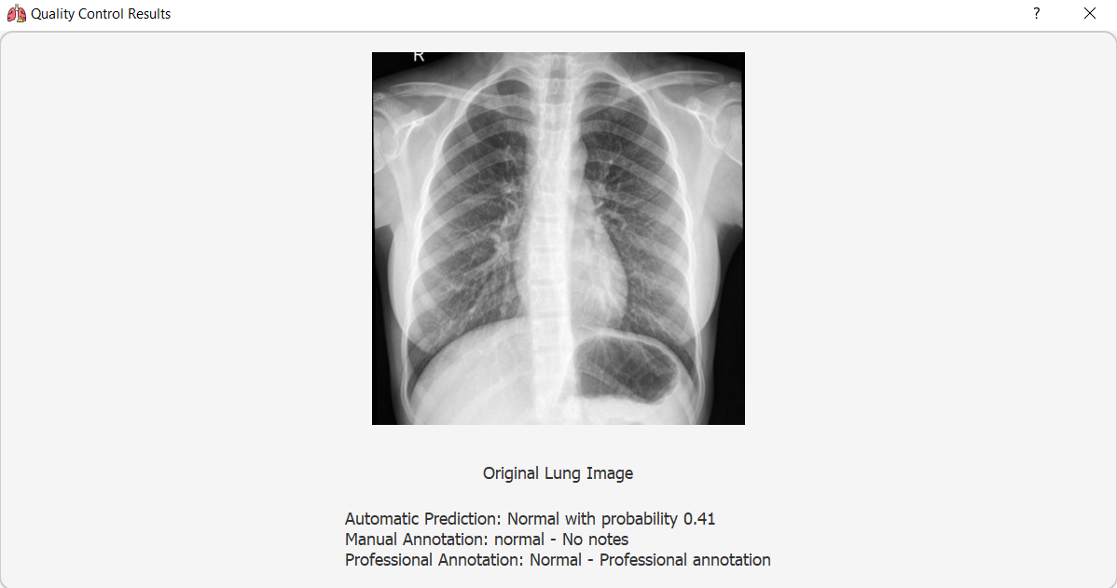
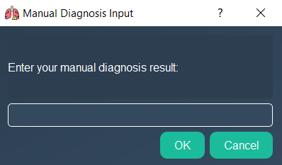
GUI

Slide 19
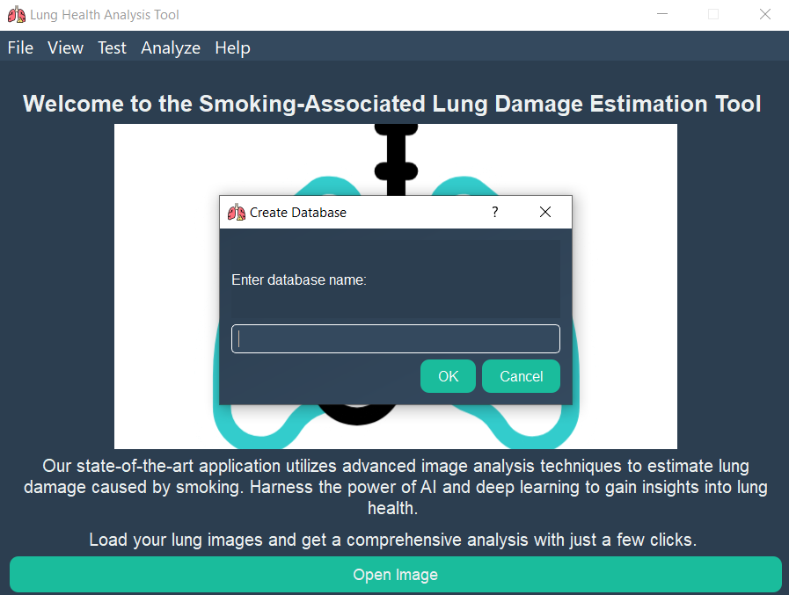
GUI

Slide 20
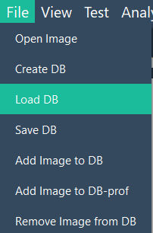
GUI

Slide 21
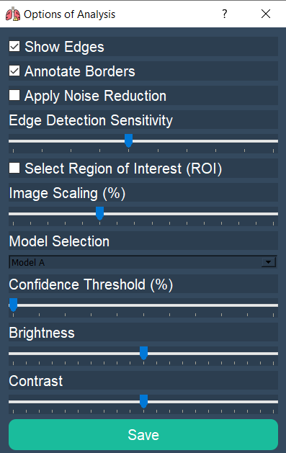
GUI

Slide 22
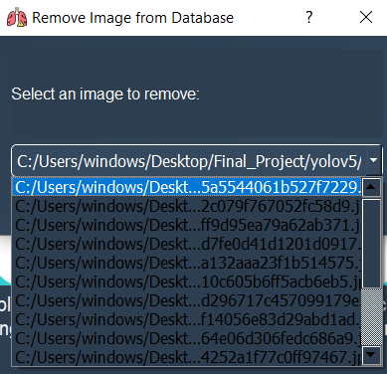
GUI

Slide 23
Final Results Overview
Our lung image analysis program has achieved significant milestones in enhancing the diagnosis of lung diseases. The final results demonstrate:
High Accuracy: Achieved an overall accuracy of 94%, effectively identifying various lung pathologies.
Improved Efficiency: Reduced the average diagnostic time by 30%, facilitating quicker clinical decision-making.

Slide 24
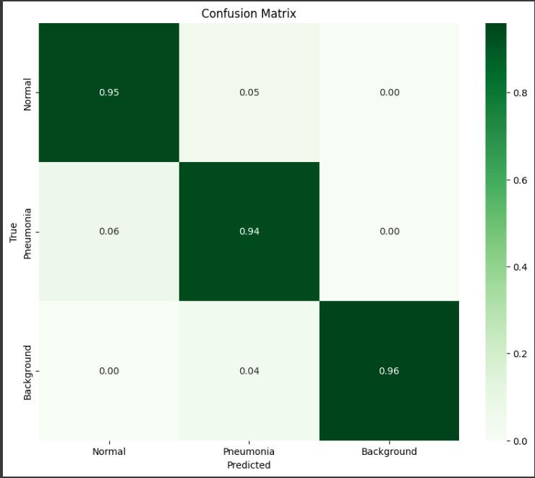
Final Results Overview

Slide 25










Video
https://drive.google.com/file/d/1pFeVUrzoQ3dWLU_ApxRUW_ps-ikK_NMj/view?usp=sharing

Slide 26
Thank you very much!

